Slide 1

SETX labor-market overview
Lauren Van Gerven
Labor Market Analyst
lauren.vangerven@setworks.org

Slide 2
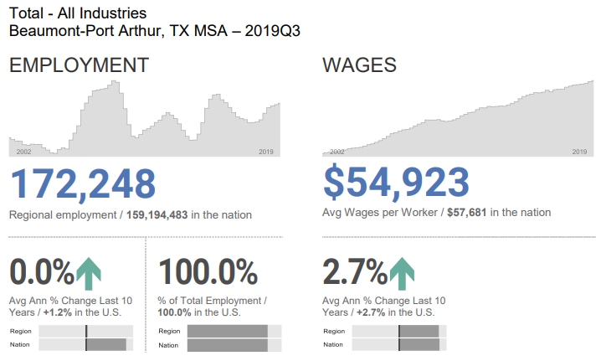

Slide 3
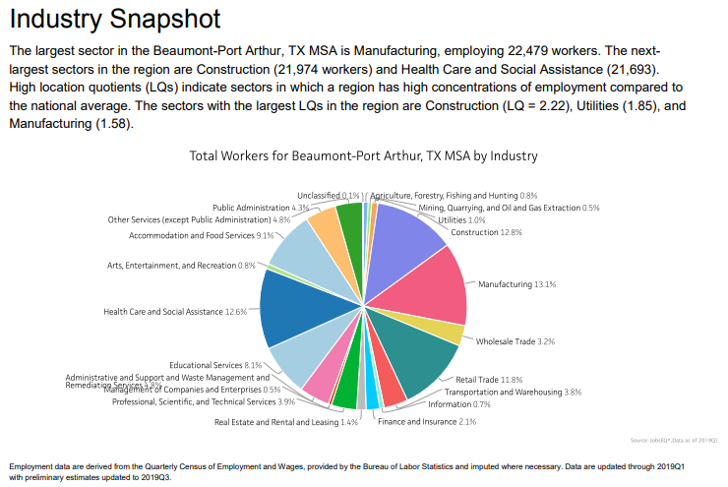
Notes:
Construction added 3,210 jobs over last 5 years – Fastest growing over last five years

Slide 4
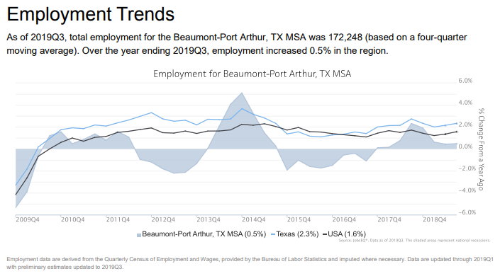

Slide 5
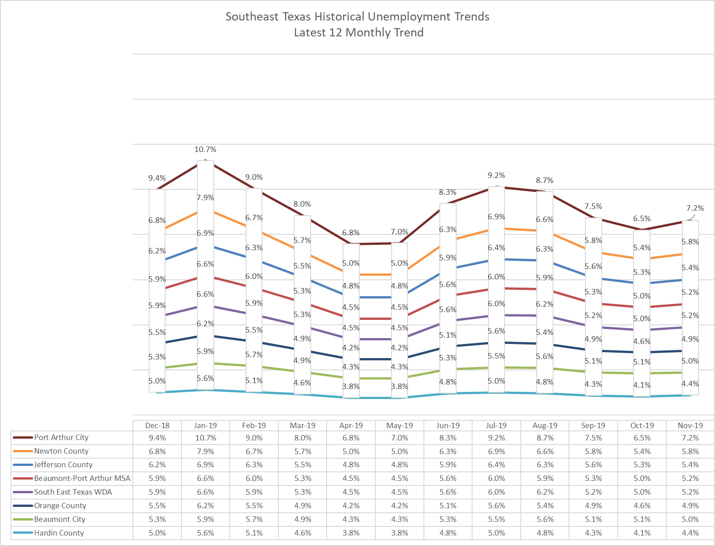

Slide 6
Manufacturing Industry

Slide 7
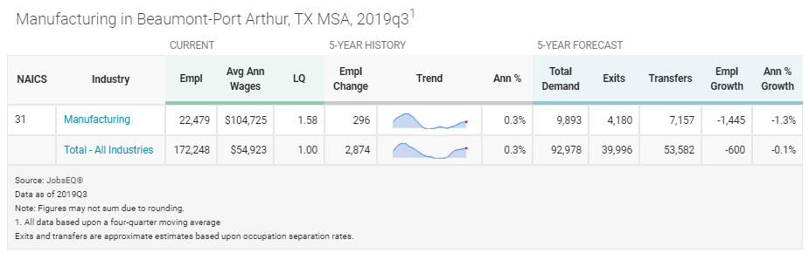
Notes:
Negative growth rate does not take away from the fact that almost 9,800 jobs will need to be filled in the next 5 years.
Recently announced expansions are not reflected in this data.

Slide 9
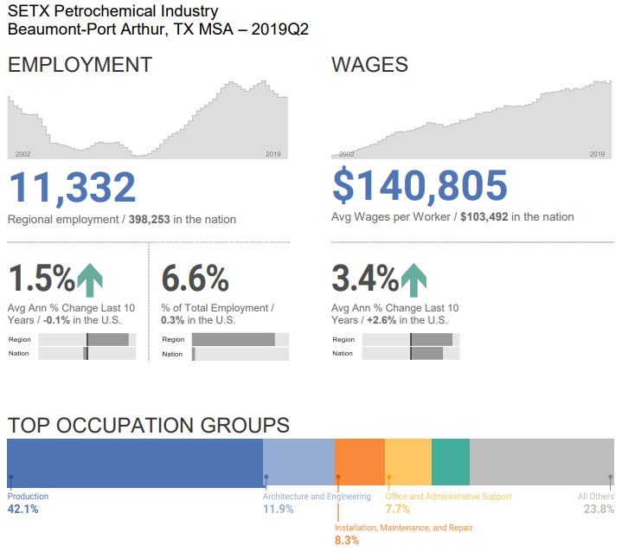

Slide 10
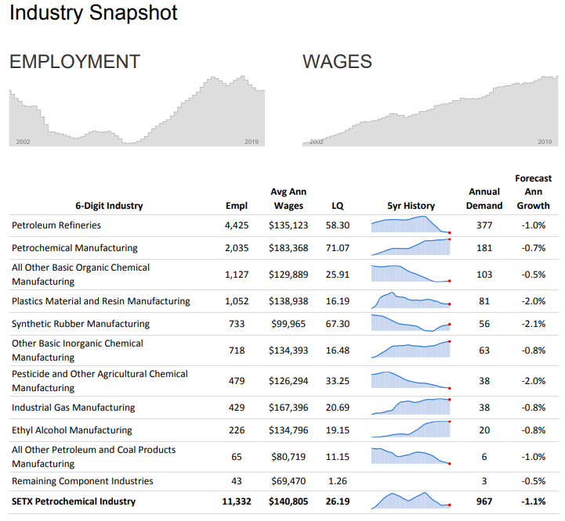

Slide 11
Construction Industry

Slide 12
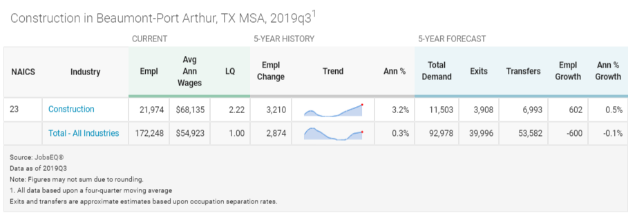

Slide 14
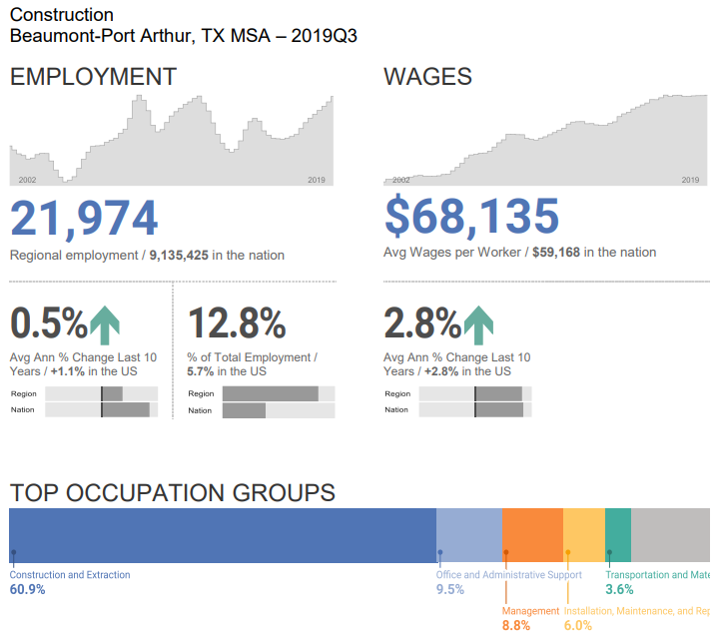

Slide 15
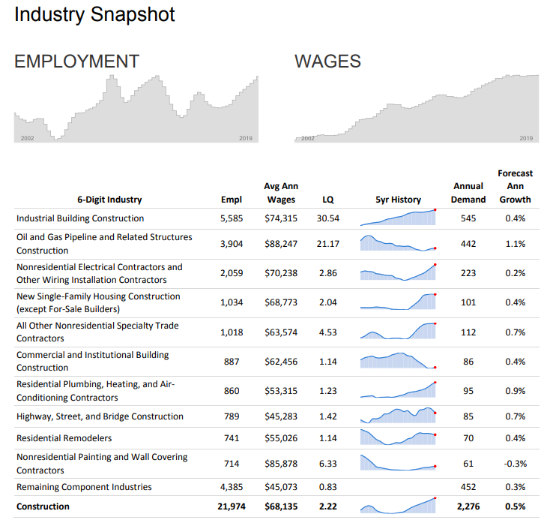

Slide 16
Demographics and Education

Slide 17

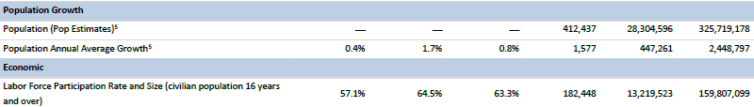
Demographic Info
LAST YEAR’S DATA
THIS YEAR’S DATA

Slide 18
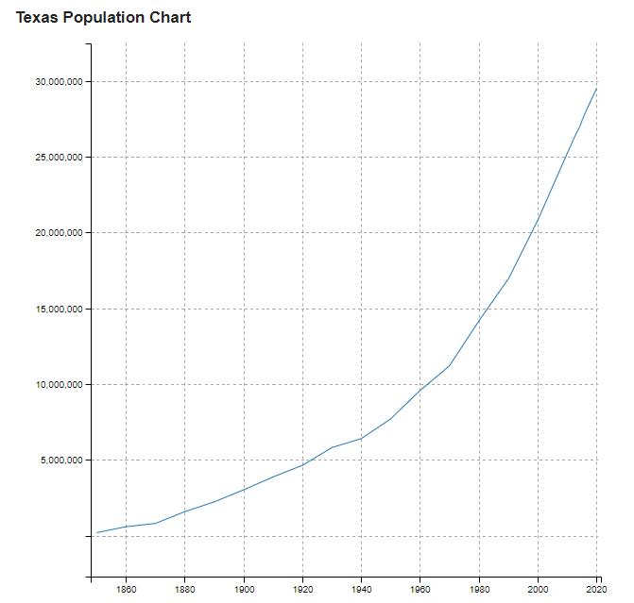
Texas added 3.6 million people since 2010
(Beaumont-Port Arthur MSA
added 1,464)

Slide 19
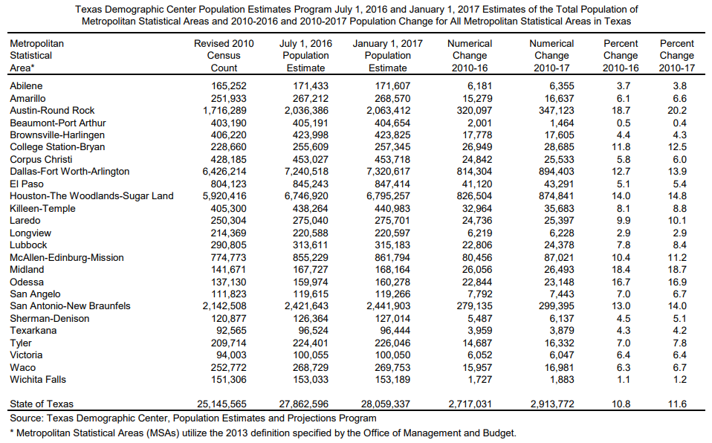
Notes:
January 2017 data, data does not take into account any population losses as a result of Hurricane Harvey

Slide 20
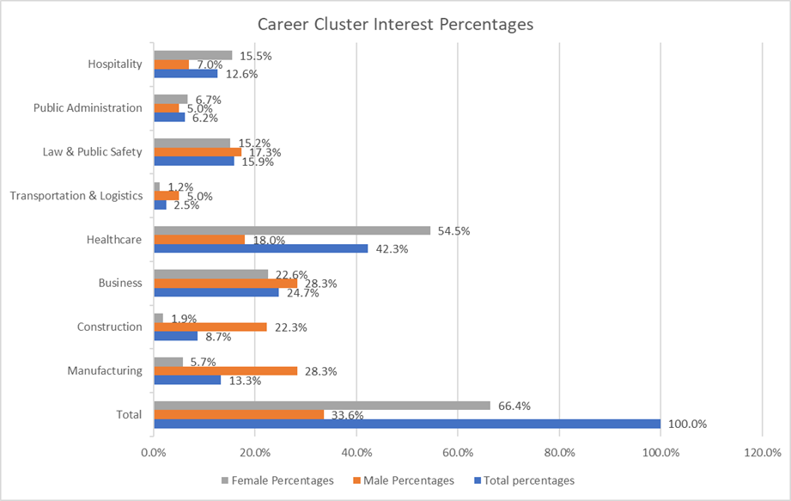
2018 Youth Expo Survey Results
894 SETX High School students participated in this survey
594 girls
300 boys
Notes:
Students aren’t aware enough of the different occupations and industries in our area.

Slide 21
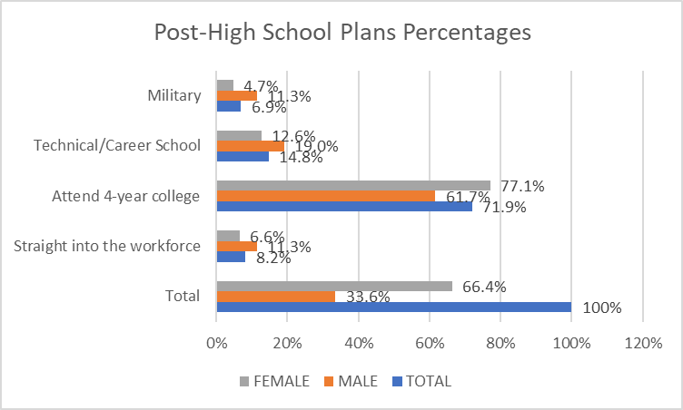
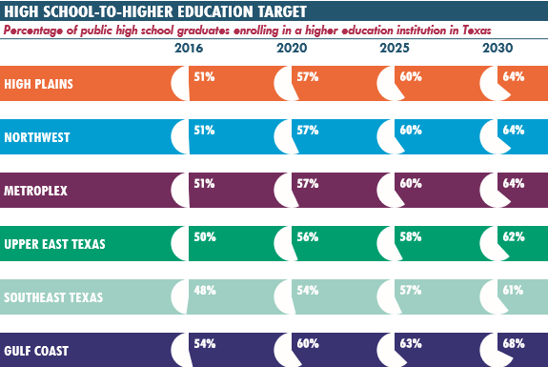
2018 Youth Expo Survey Results
Notes:
72% of surveyed students (juniors and seniors) said they plan on attending a 4-year college, yet only 48% of students enroll. What happens to the students who change their mind last minute? They need to be aware of all options/have a plan B to avoid falling between the cracks.

Slide 22
Employer Services

Slide 23
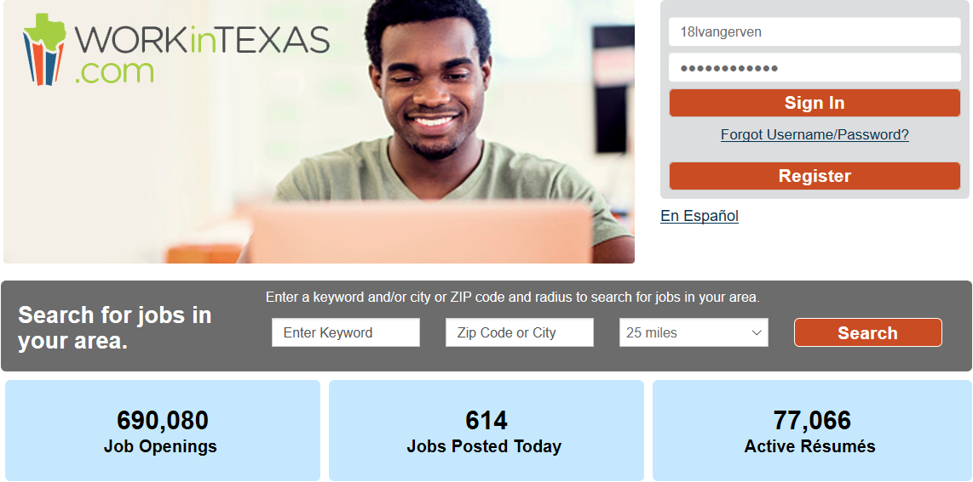

Slide 24


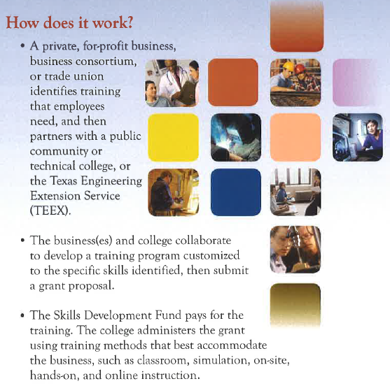
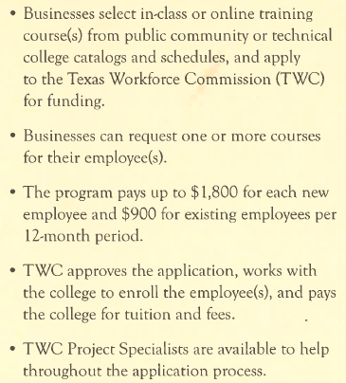

Slide 25
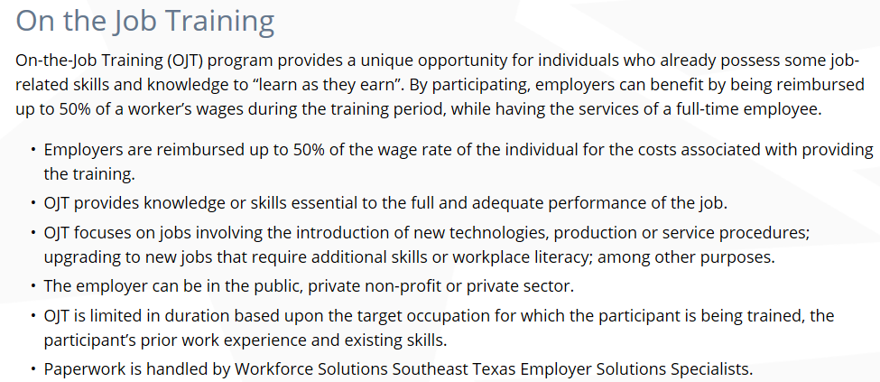

Slide 26
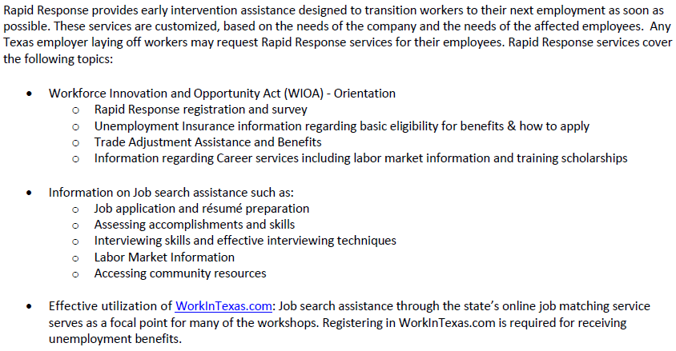
Rapid Response
1-877-834-5627

Slide 27

Rescheduled Youth Career Expo
Thursday, Feb. 6, 2020

Slide 28

Thank you
Lauren Van Gerven
lauren.vangerven@setworks.org
(409) 719.4756

